Slide 1
Communication Protocol

Slide 2

Classification of communication
Depending on the mode of data transfer it is classified as
SERIAL COMMUNICATION
PARALLEL COMMUNICATION

Slide 3
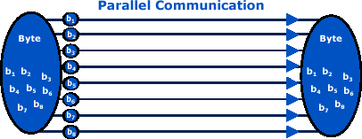


Serial v/s Parallel
Serial Communication
Parallel Communication
Uses single data line for data transfer
Suitable for long distance communication.(50feet)
Cheaper but slower
requires parallel in serial out shift register at TX and serial in parallel out shift register at RX.
Uses 8 or more data lines for data
Suitable for small distance communication.(15feet)
Transfer faster and expensive
Costlier extra circuit is not required

Slide 4
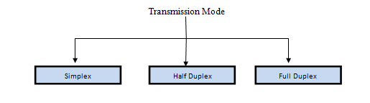


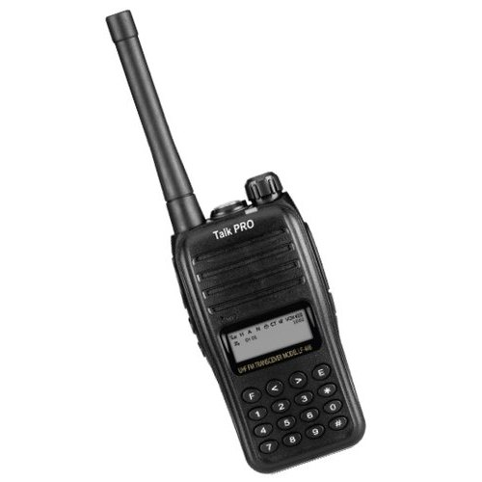
Transmission Modes

Slide 5
METHODS OF SERIAL COMMUNICATION
SYNCHRONOUS SERIAL COMMUNICATION
ASYNCHRONOUS SERIAL COMMUNICATION

Slide 6
SYNCHRONOUS v/s ASYNCHRONOUS
SYNCHRONOUS
ASYNCHRONOUS
Communication takes place between a transmitter and a receiver operating on synchronized clocks.
Transfers block of data at a time
start, stop and control and error correction sequences around large continuous data blocks
faster
Communication is performed between two (or more) devices which operate on independent clocks
Transfers Single byte at time
start, stop and parity bits around individual words
slower

Slide 7
UART

Slide 8
Features
TM4C123GH6PM microcontroller has got eight UART ports.
In the TI Launchpad, the UART0 port is connected to the ICDI (In-Circuit Debug Interface).
Standard asynchronous communication bits for start, stop, and parity.
Fully programmable serial interface characteristics
5, 6, 7, or 8 data bits
1 or 2 stop bit generation

Slide 9
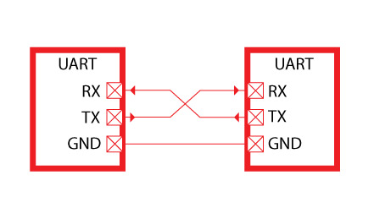
UART Connection

Slide 10
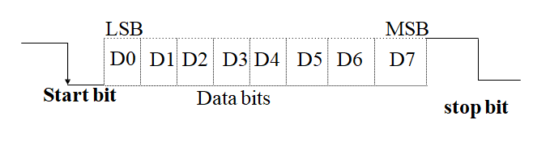
UART DATA FRAME

Slide 11

Start
Set Clock frequency
SysCtlClockSet(SYSCTL_SYSDIV_4 | SYSCTL_USE_PLL | SYSCTL_XTAL_16MHZ| SYSCTL_OSC_MAIN);
Enable Port A and UART0 Module
SysCtlPeripheralEnable(SYSCTL_PERIPH_GPIOA);
Configure Port A pin0 as RX and PortA pin 1 as Tx
SysCtlPeripheralEnable(SYSCTL_PERIPH_UART0);
Configure Pins as UART pins
GPIOPinConfigure(GPIO_PA0_U0RX);
GPIOPinConfigure(GPIO_PA1_U0TX);
Select the Clock Source for UART module
GPIOPinTypeUART(GPIO_PORTA_BASE, GPIO_PIN_0 | GPIO_PIN_1);
UARTClockSourceSet(UART0_BASE, UART_CLOCK_PIOSC);
Set baud rate
UARTStdioConfig(0, 9600, 16000000);
Pass the data
UARTprintf("Hello from Tiva\n");

Slide 12
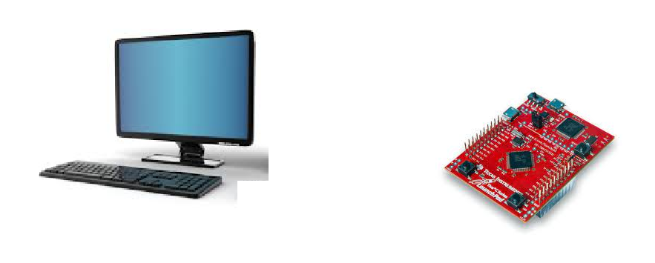
Assignment
Configure UART to receive data from PC.
Output to Monitor
Input
From
Keyboard
Microcontroller receives
Data via USB

Slide 13
16x2 LCD Display

Slide 14
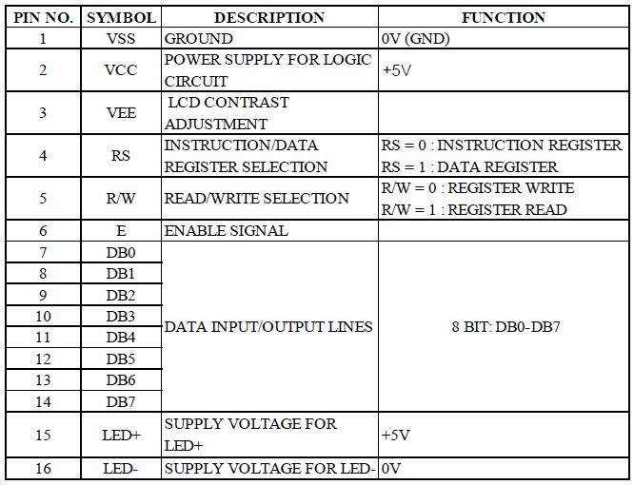
LCD Display Pins

Slide 15
LCD Commands:
* | Hex | Command to LCD Instruction Register |
* ------------------------------------------------------
* 0X0F LCD ON , Cursor ON
* 0x01 Clear Screen
* 0x02 Return Home
* 0x04 Shift Cursor to Left
* 0x05 Shift Display right
* 0x06 Shift Cursor to Right
* 0x07 Shift Display left
* 0x0E Display On Cursor Blinking
* 0X80 Force Cursor to Beginning of First line

Slide 16
LCD Command Continue
* 0XC0 Force Cursor to Beginning of Second line
* 0X38 2 lines and 5×7 matrix
* 0X83 Cursor line 1 position 3
* 0x3C Activate second line
* 0X08 Display OFF, cursor OFF
* 0X0C Display ON, cursor OFF
* 0XC1 Jump to second line, position 1
* 0XC2 Jump to second line, position 2

Slide 17
Pin Functions
RS=0 INSTRUCTION
1 DATA REGISTER SELECTION
RW=0 REGISTER WRITE
1 REGISTER READ
E=1 ENABLE
0 Disable

Slide 18
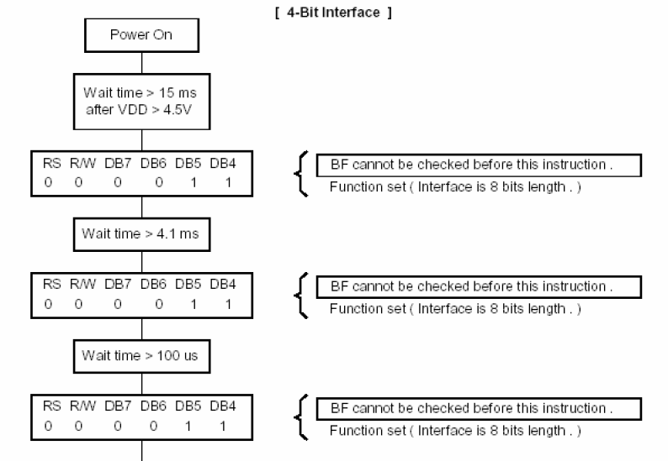
4 bit Initialization

Slide 19
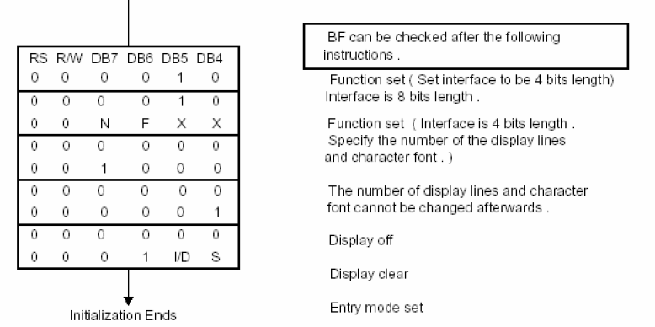
Continue….

Slide 20
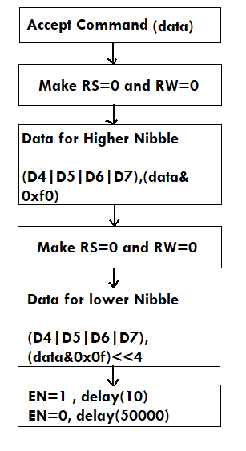
Writing the command to LCD

Slide 21
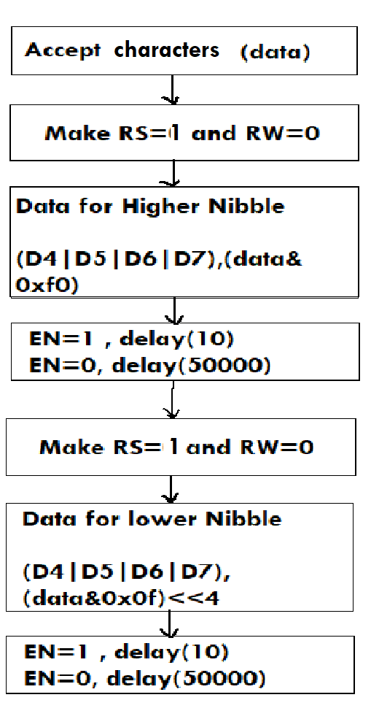
Writing Character to LCD Display

Slide 22
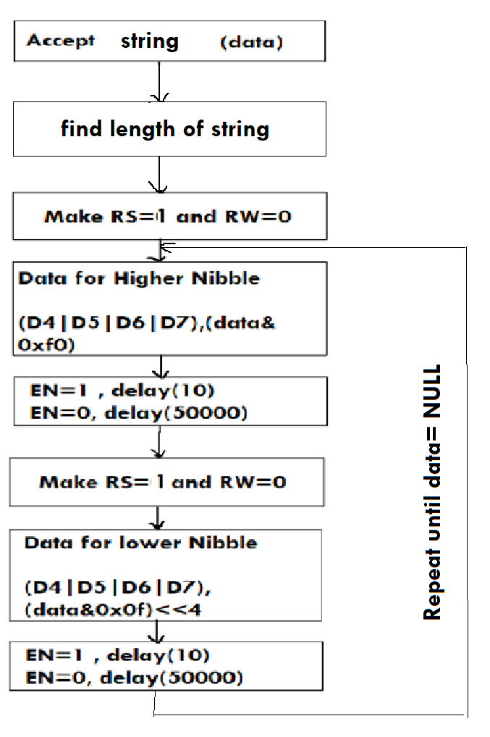
Writing String to LCD

